Slide 1
OLAP Cubes
Absence.abf
Discipline.abf
PerformanceCube.abf
SpecialProgram.abf

Slide 2
Created OLAP cubes using Microsoft Visual Studio – Analysis Services Multidimensional BI project
Imported data source
Created Data source view
Created cubes using the data source view
Cube contains measures and dimension and which we used for BI visualizations
Following slides have screenshots for the cube structures of each cube created out of data view

Slide 3
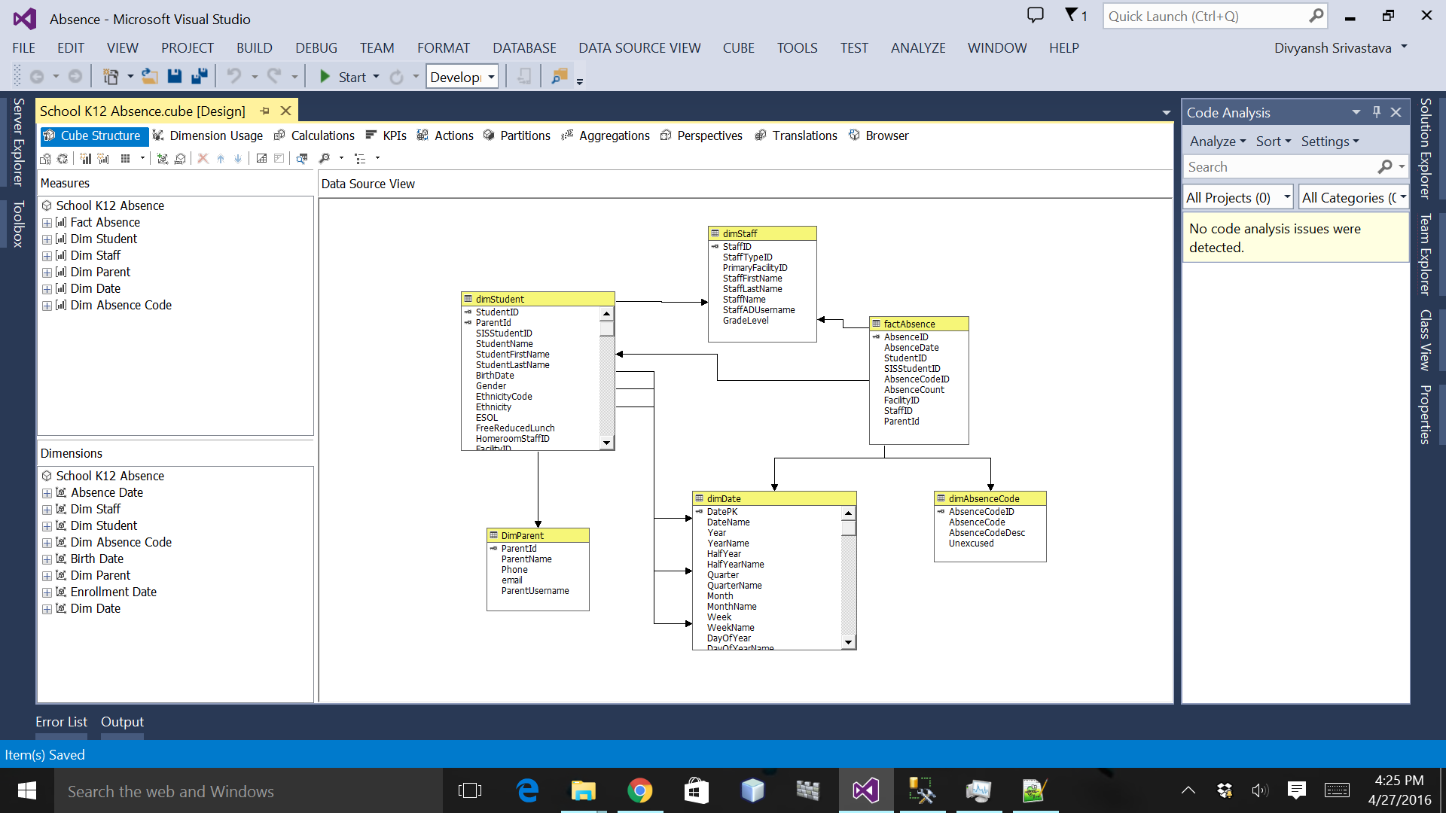
Absence

Slide 4
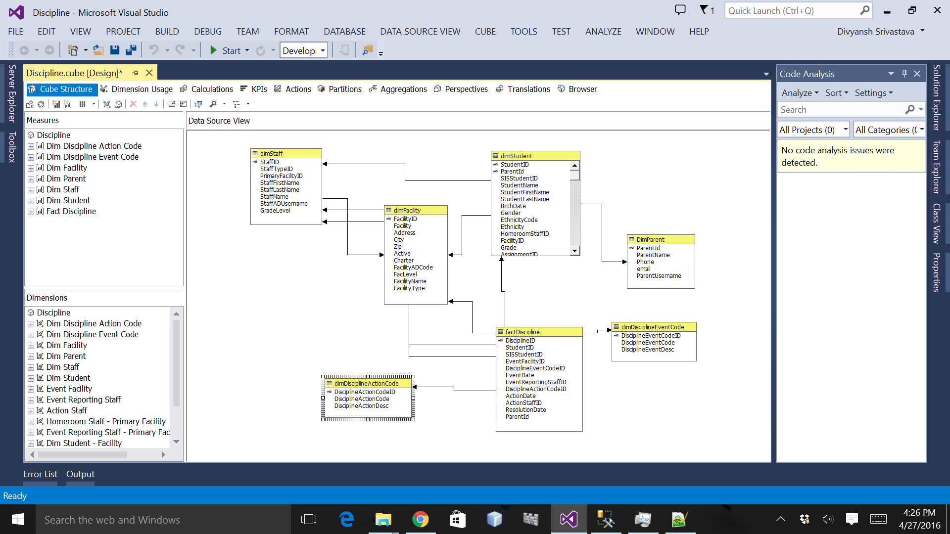
Discipline

Slide 5
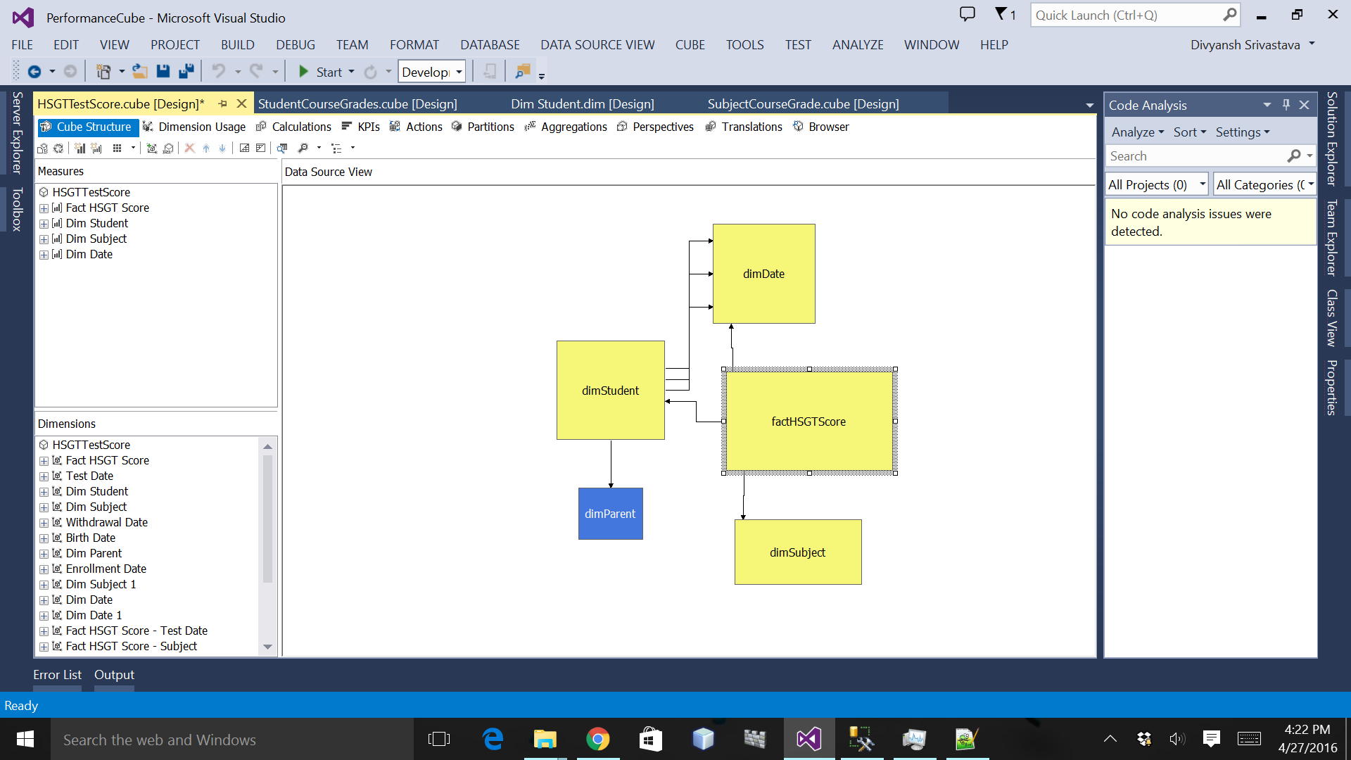
Performance

Slide 6
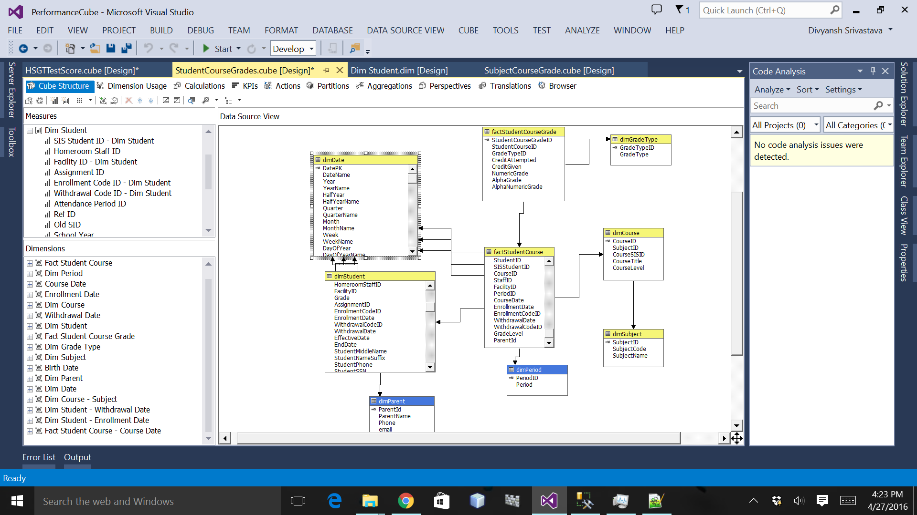

Slide 7
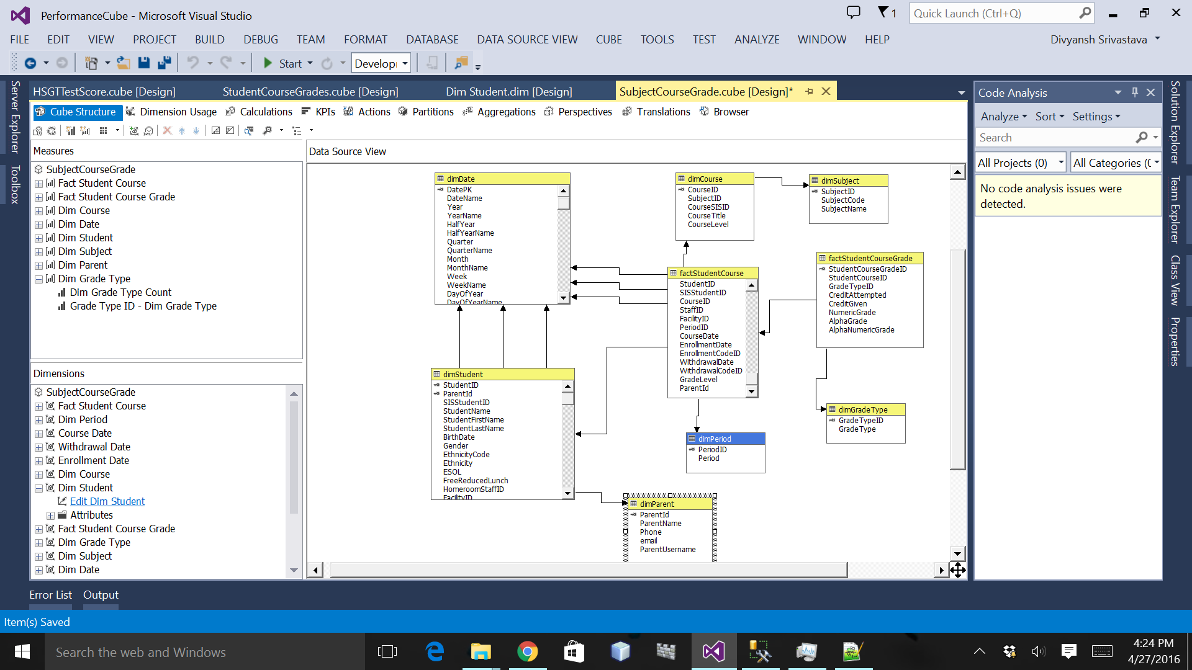

Slide 8
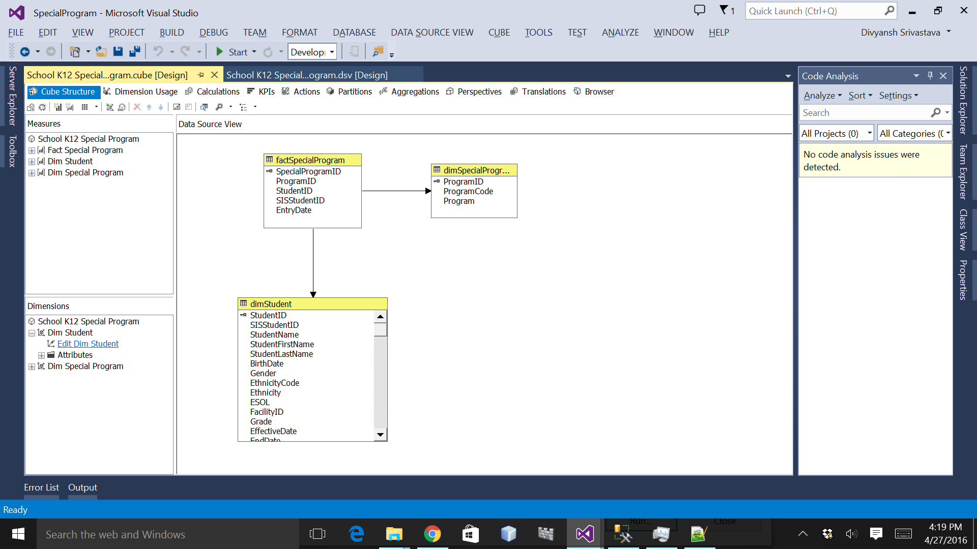
Special Program

